Slide 1
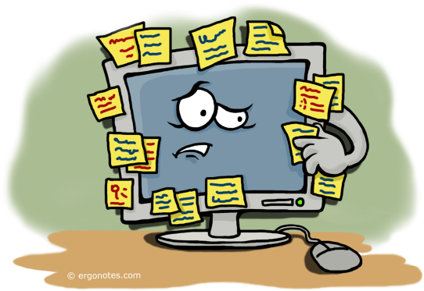




ALWAYNOTE WEB APPLICATION

Slide 2
Index
Introduction of the Application
Application Profile
Scope Of the System
Modules & Users
Tools & Technology
Need for the System
System Flow Diagrams
UML Diagrams
Data Dictionary

Slide 3
Introduction
We know how important it is to take notes regularly. And you make an effort capture ideas everyday. You also spend time recording your thoughts. You’re a writer, you need a note taking app you can depend on. This way you can spend more time developing your ideas and less time waiting for inspiration to arrive.
Don’t worry we've got your back with our newest alwaynotes application. which will help you out with all those problems you face normally without a finest note taking app.
Our app covers all those useful modules which are currently rare to find in a single app. Which includes all those basic adding, modifying, deleting features. Along with search options, voice recognition, To-do list, Sketch mode, text file upload fir editing and merging.

Slide 4
Application Profile
The idea of making such a software came into life when we thought of creating something that can note whatever and whenever.
That was followed by a thought of making it in such a way that it comprises from normal text files and also is a platform that supports various coding languages.
The plan includes the software having the features that most of the note taking apps contain such as drawing, importing image etc. We also added the voice activation feature to create a new note as well as typing i.e, speech to text.

Slide 5
Scope of the Project
The main scope of the system is to create a note taking application and make one’s effortless as he/she can get creative in their respective disciplines’ as well as store data using this software rather than jumping from one to another.
Users can easily create or access the note files. Can also maintain their profile time to time whenever they want to.
Also speech recognition feature for flexibility of the application.

Slide 6
Tools and Technologies used
Tool:-
Backend user- Django
Frontend user- Django
Database- SQL
Technologies:-
Xampp Server
Visual studio

Slide 7
Modules
Those who can access:
Admin
User

Slide 8
Admin
Admin can manage users by adding, updating and deleting the users inside the application.
Admin can view the feedbacks left by the users for the betterment of the application.

Slide 9
User
Users can access the application by login in and logging out. And if someone is not already the user they can create a new account.
Users can create a new note whenever they want to. It can be done manually or by utilising the voice recognition feature by only saying, ”hey note”.
Users can view their existing files and later can also edit or delete.
Users can update their profiles by changing profile pictures or by changing password.
Users can also give feedbacks, as it promotes sense of self-efficacy.

Slide 10
Need for the Project
In this project we have followed students- centered approach in which we solved the realistic problems and complex processes into one simple solution.
Firstly we took into a consideration a situation in which an individual has an idea which he/she notes down into a note taking application and then executes that idea into a programming application which is a hectic job.
Therefore we thought of a software that can carry out both. The software also contains features that a normal note taking app does not.

Slide 11
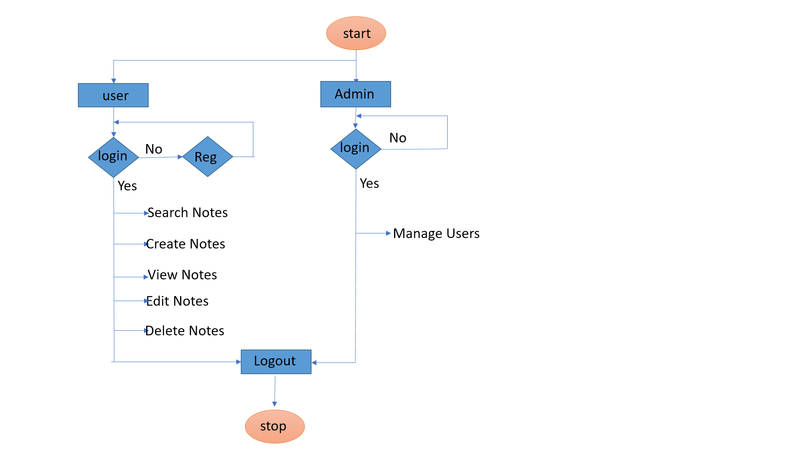
Analysis
System flow diagram

Slide 12
UML Diagram

Slide 13
Use Case Diagram

Slide 14
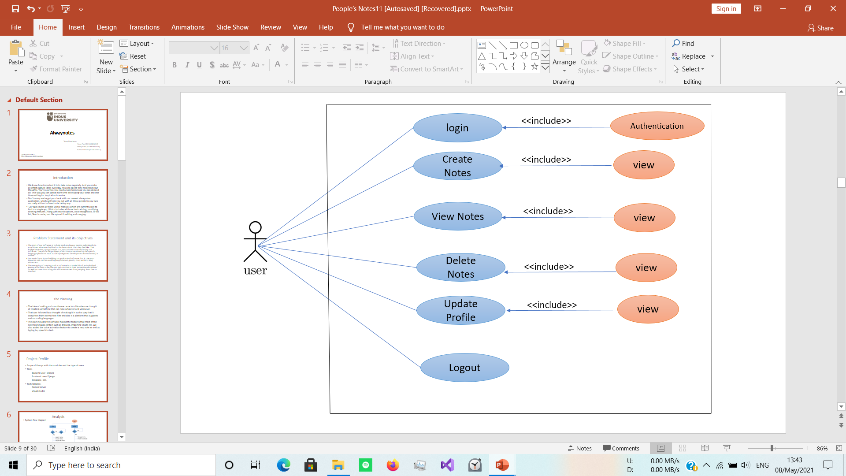
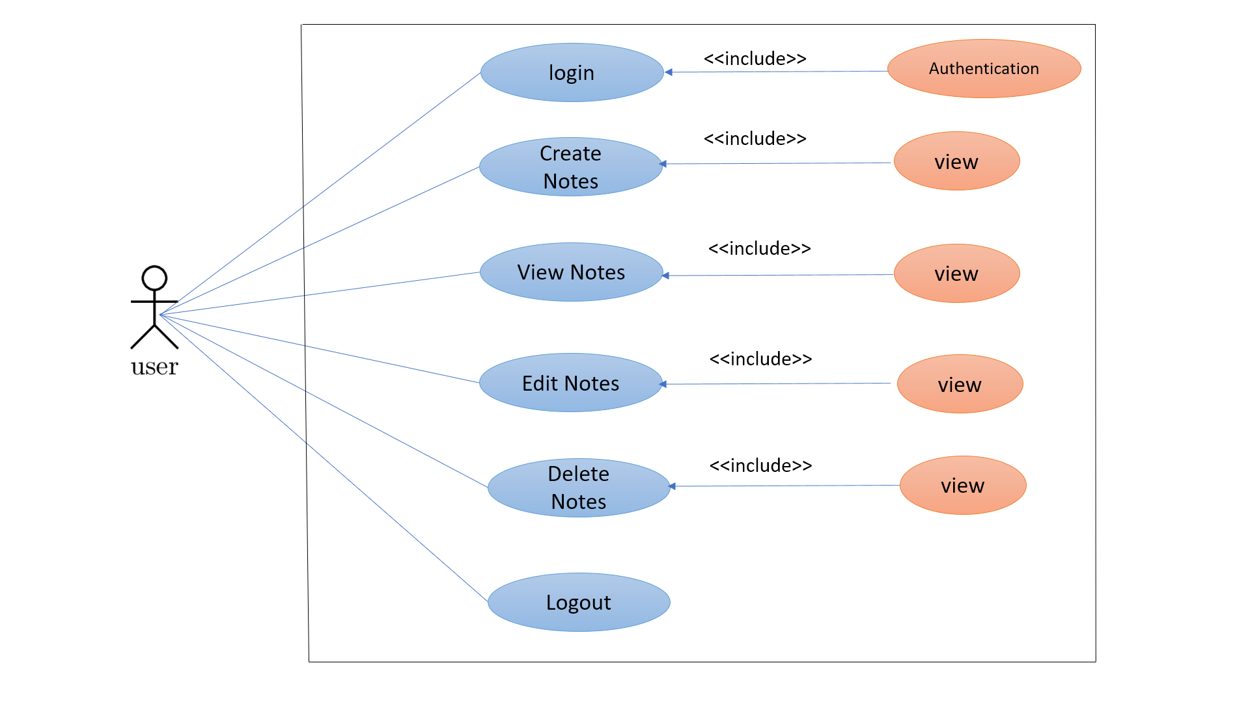
Sub Use-Case Diagram (User)
Sub Use-Case Diagram (User)

Slide 15
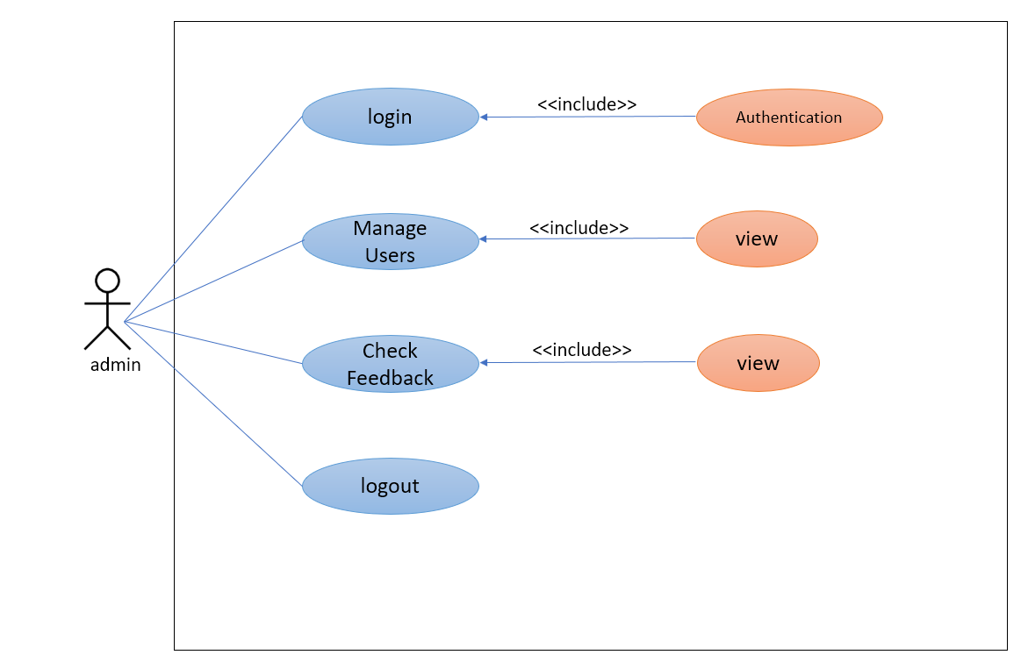
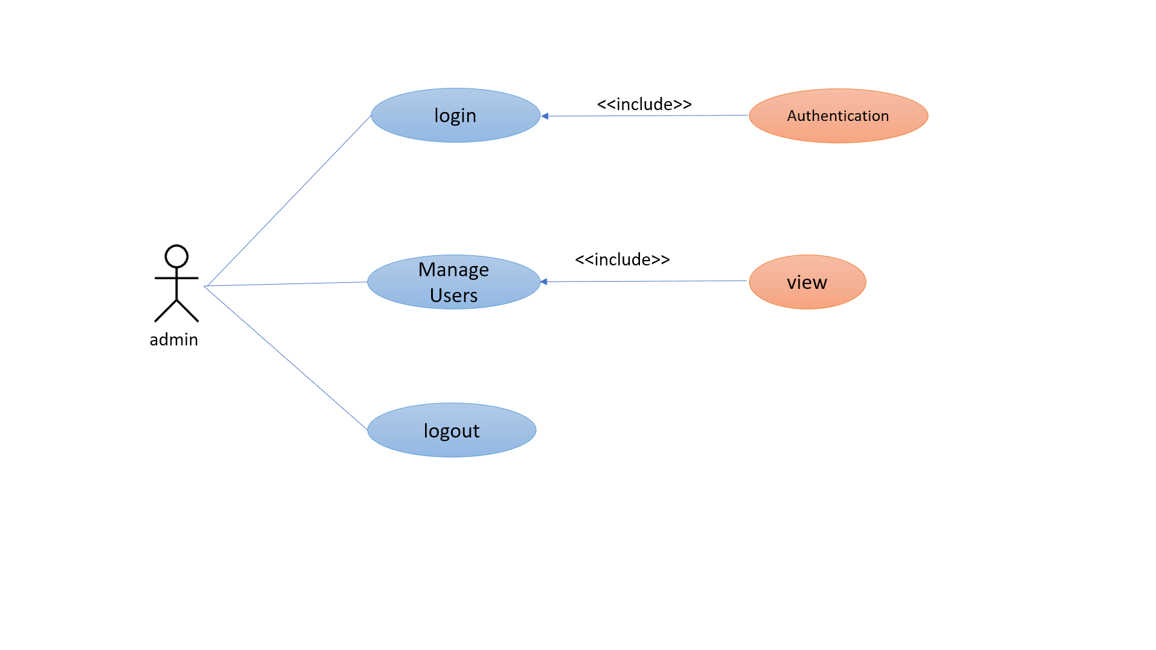
Sub Use-Case Diagram (Admin)

Slide 16
Activity Diagram

Slide 17
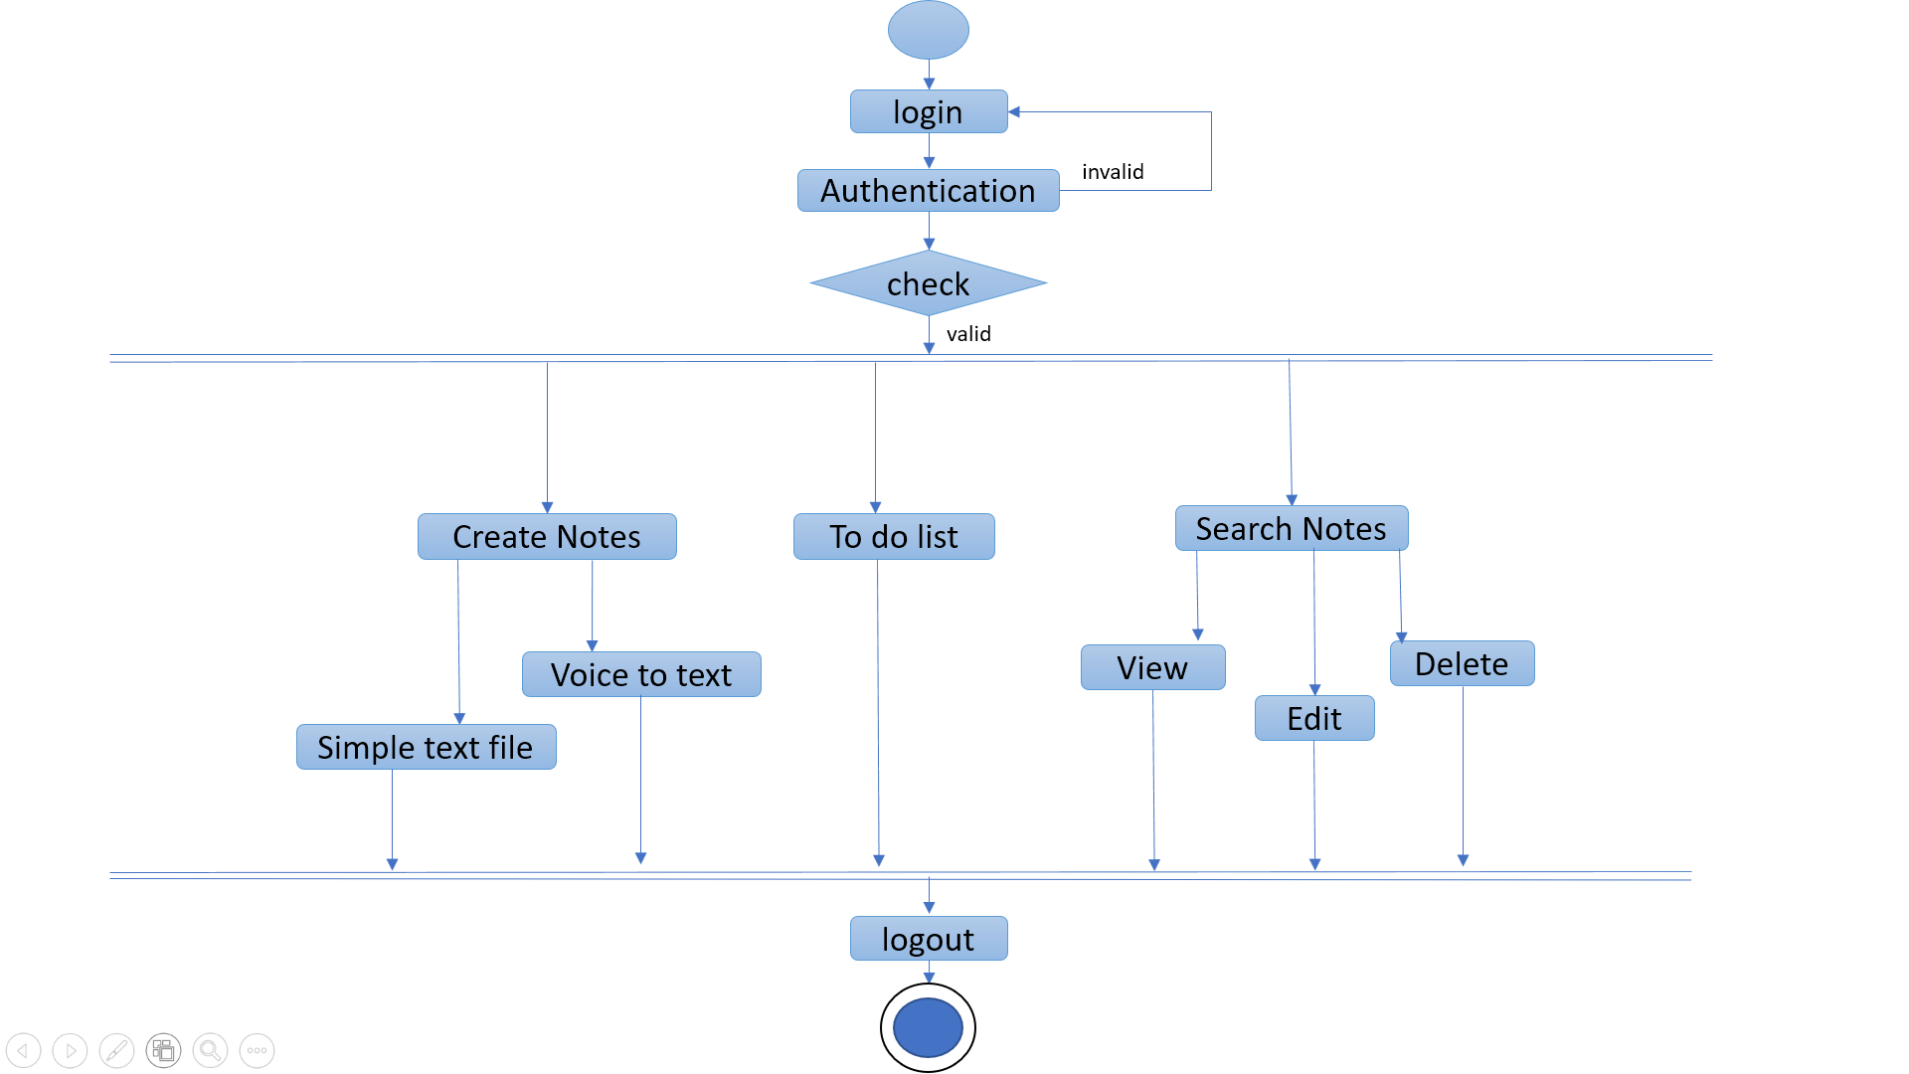
Activity Diagram for user

Slide 18
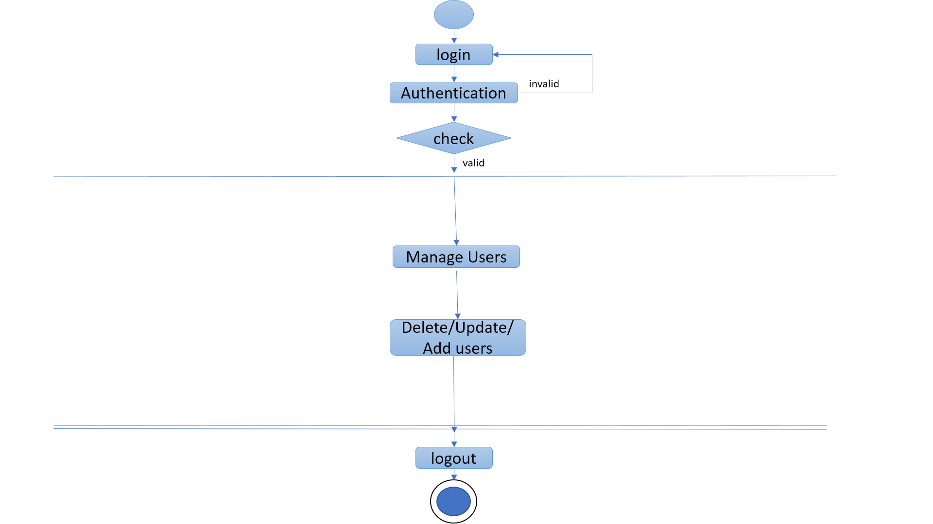
Activity Diagram for Admin

Slide 19
Data Dictionary

Slide 20
List of Tables
Master Table
UserTable
Transaction Table
NotesTable
TodoList

Slide 21
UserTable
Fields | Datatype | Constraints | IsNull
UserID | int | PK + IDENTITY | No
username | Varchar(100) | UNIQUE | No
Email | varchar(150) |  | No
Password | varchar(100) |  | No

Slide 22
NotesTable
Fields | Datatype | Constraints | IsNull
UserID | int | FK(UserTable) | No
Nid | varchar(150) | PK | No
Ntitle | Varchar(100) | UNIQUE | No
Ncontent | Varchar(255) |  | no
created_at | DateTime |  | No

Slide 23
TodoTable
Fields | Datatype | Constraints | IsNull
UserID | int | FK(UserTable)
TdID | int | PK | No
title | boolean |  | No
tcontent | Varchar(200) |  | No
tcreatedat | DateTime |  | No

Slide 24
Project Screenshots

Slide 25
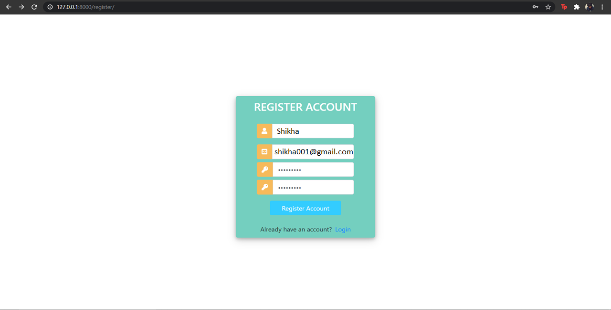
Register Page:

Slide 26
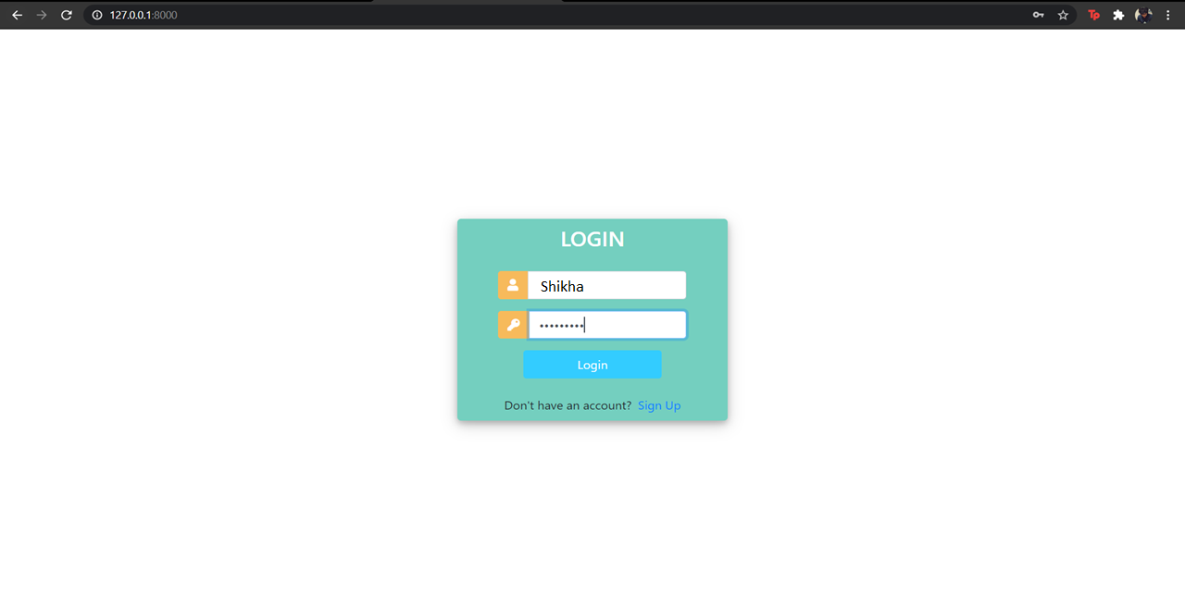
Login Page:

Slide 27
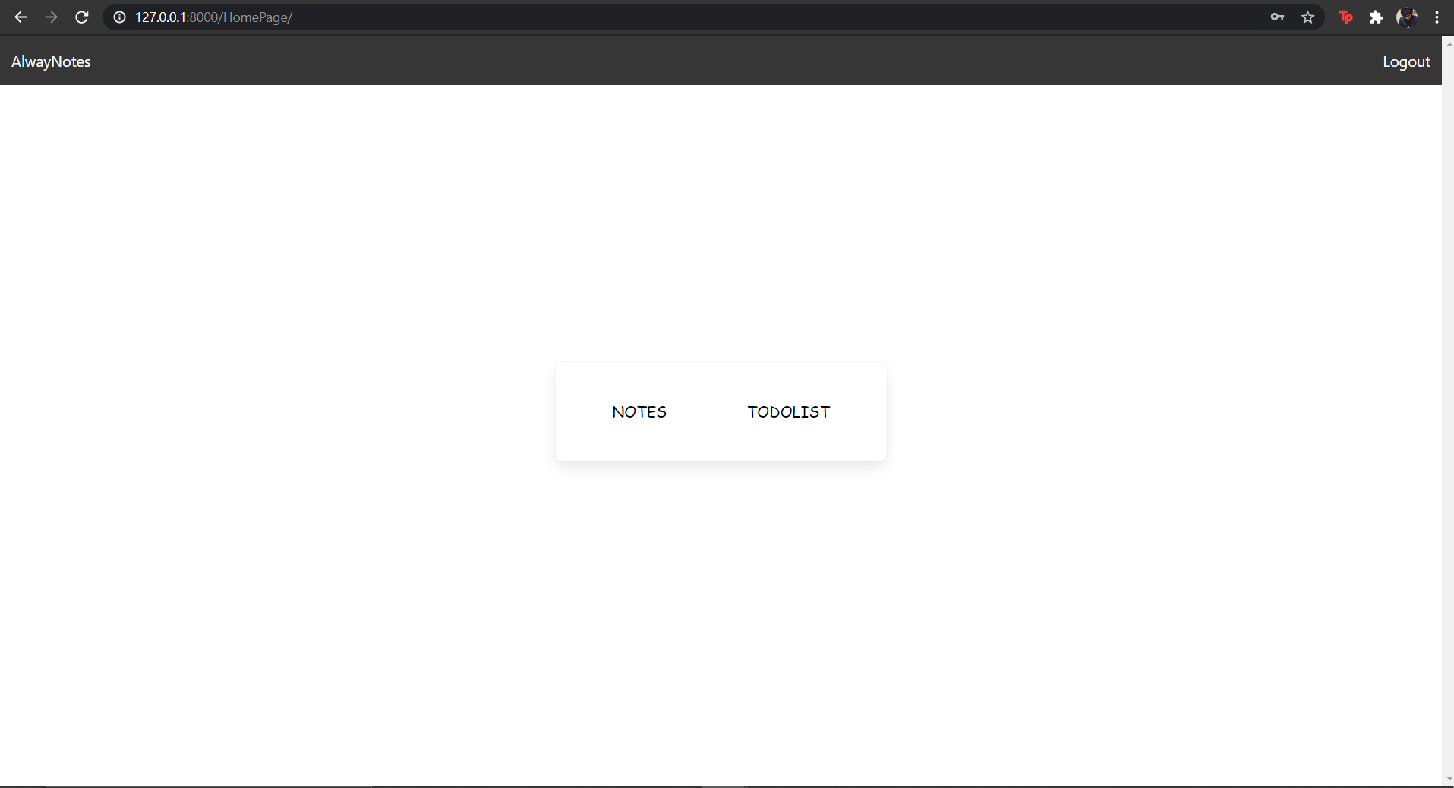
Home Page:

Slide 28
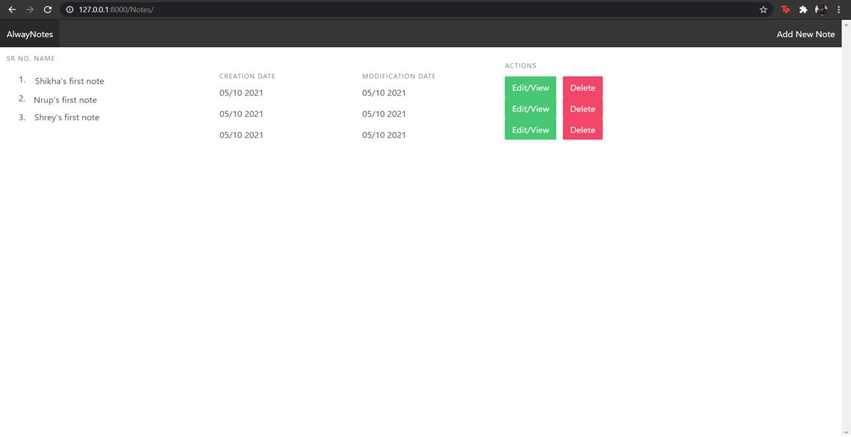
Notes Page:

Slide 29
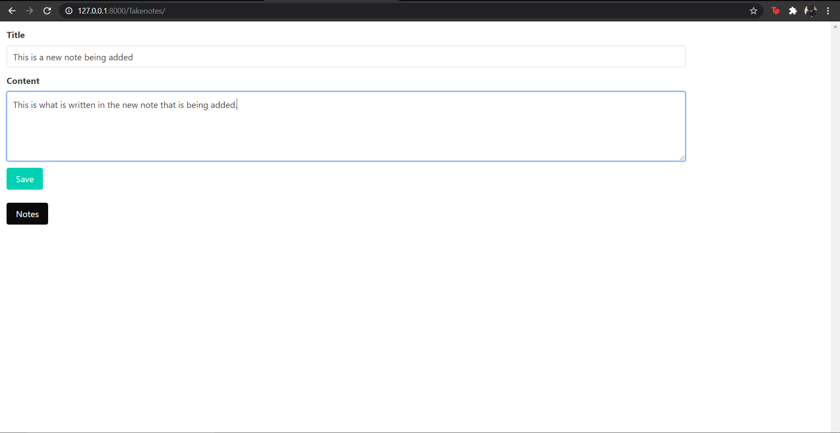
Adding a new note:

Slide 30
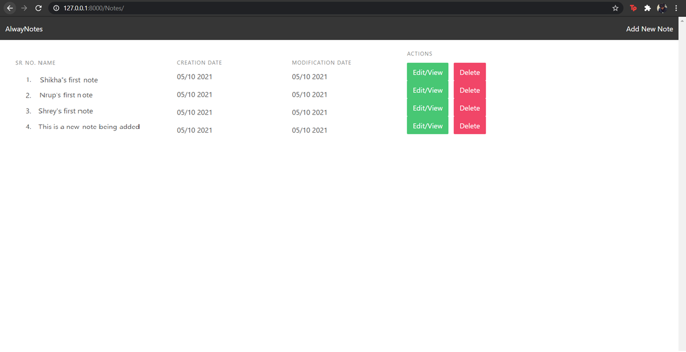
New Note Added:

Slide 31
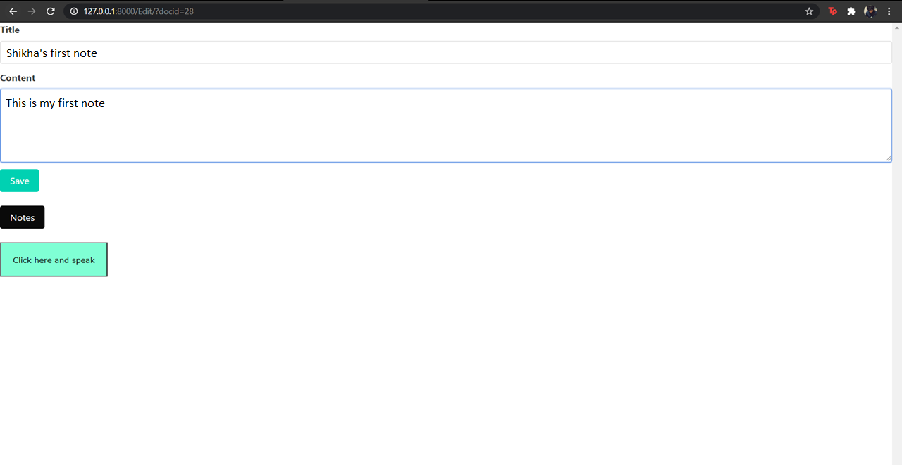
Editing an existing note:

Slide 32
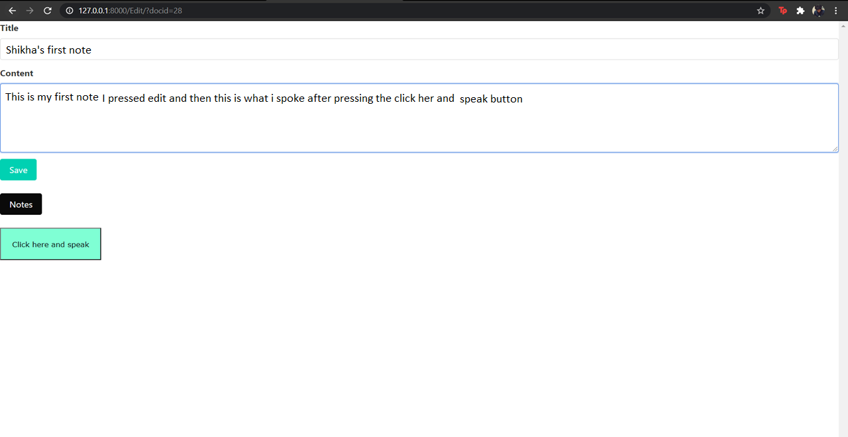
Using voice to edit the note:

Slide 33
Note updated:

Slide 34
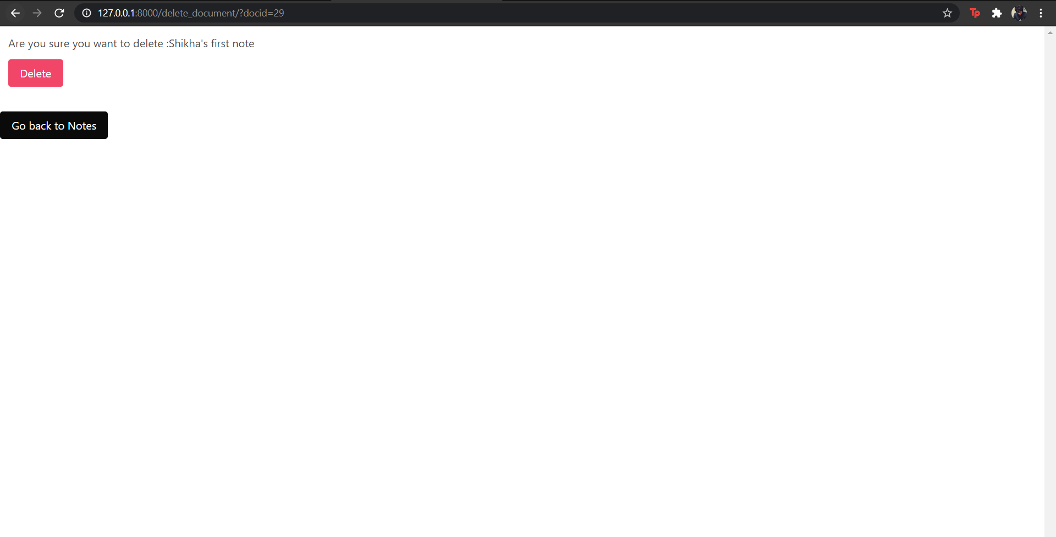
Deleting an existing note:

Slide 35
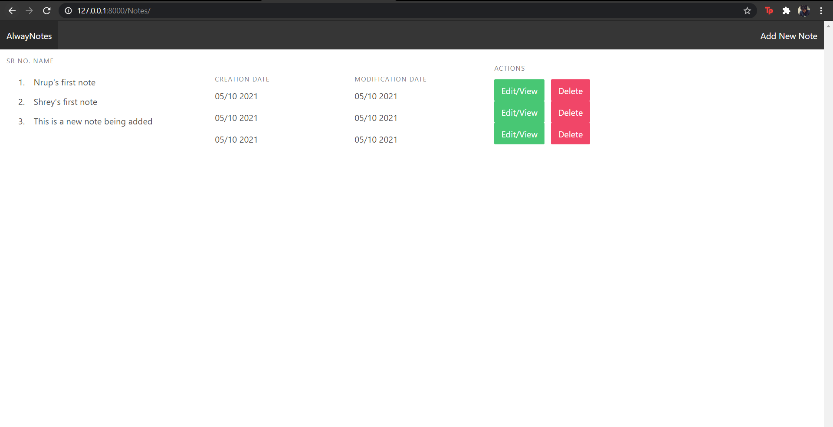
Note deleted:

Slide 36
Going for To-do page:

Slide 37
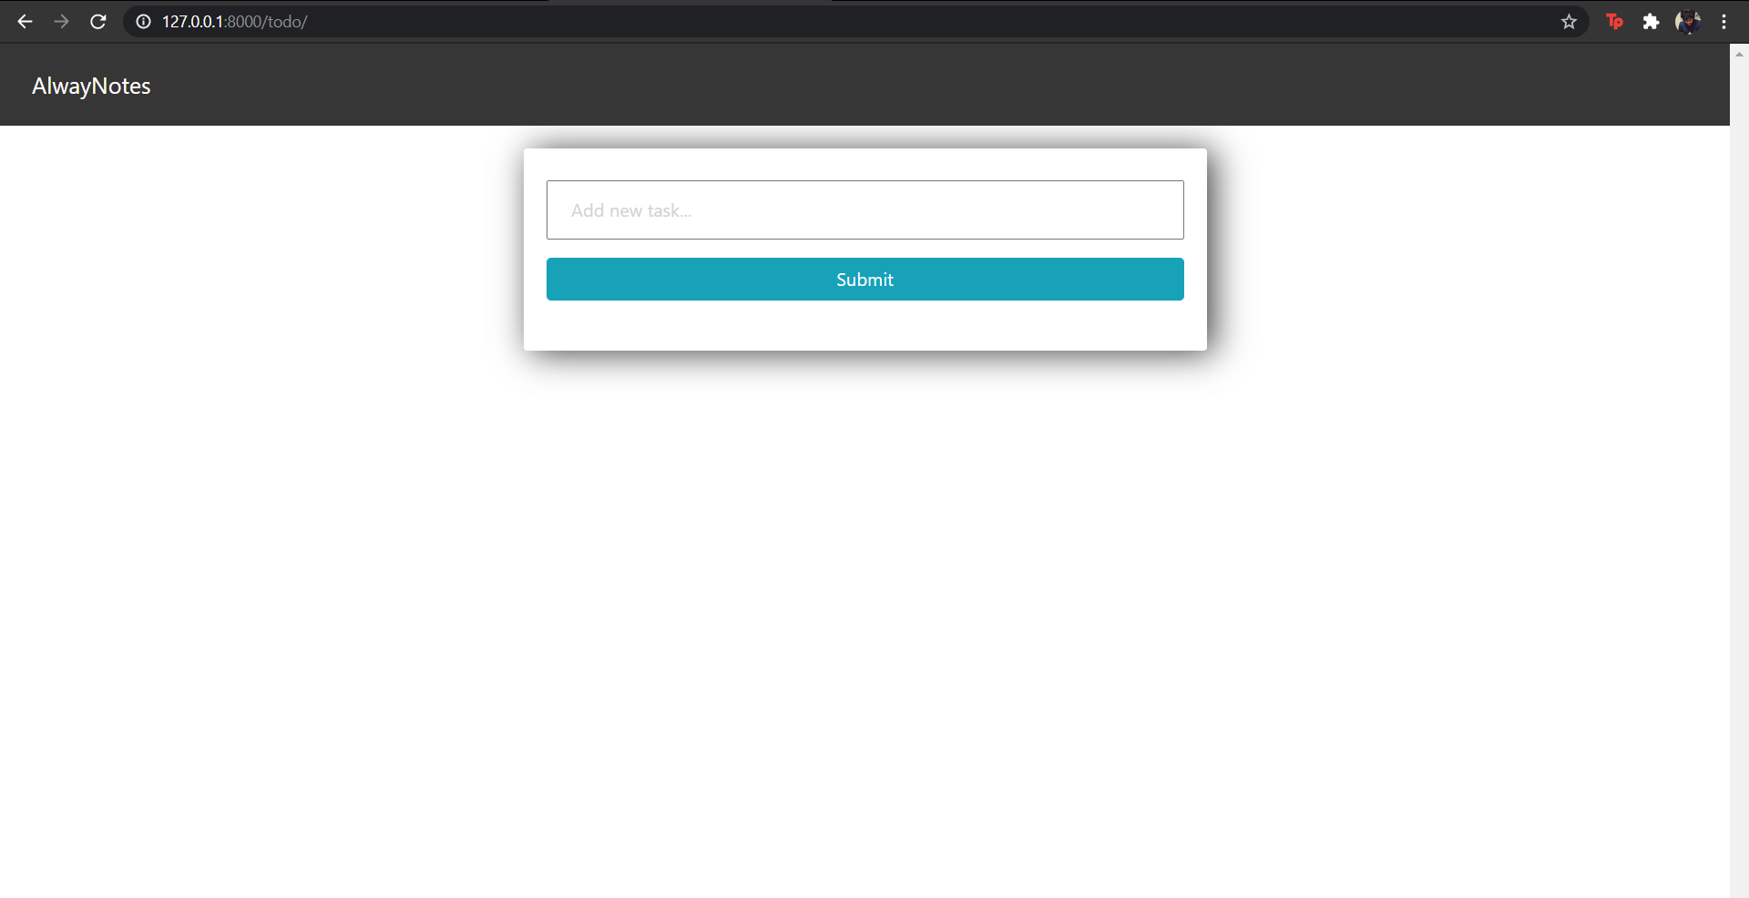
To-do Page:

Slide 38
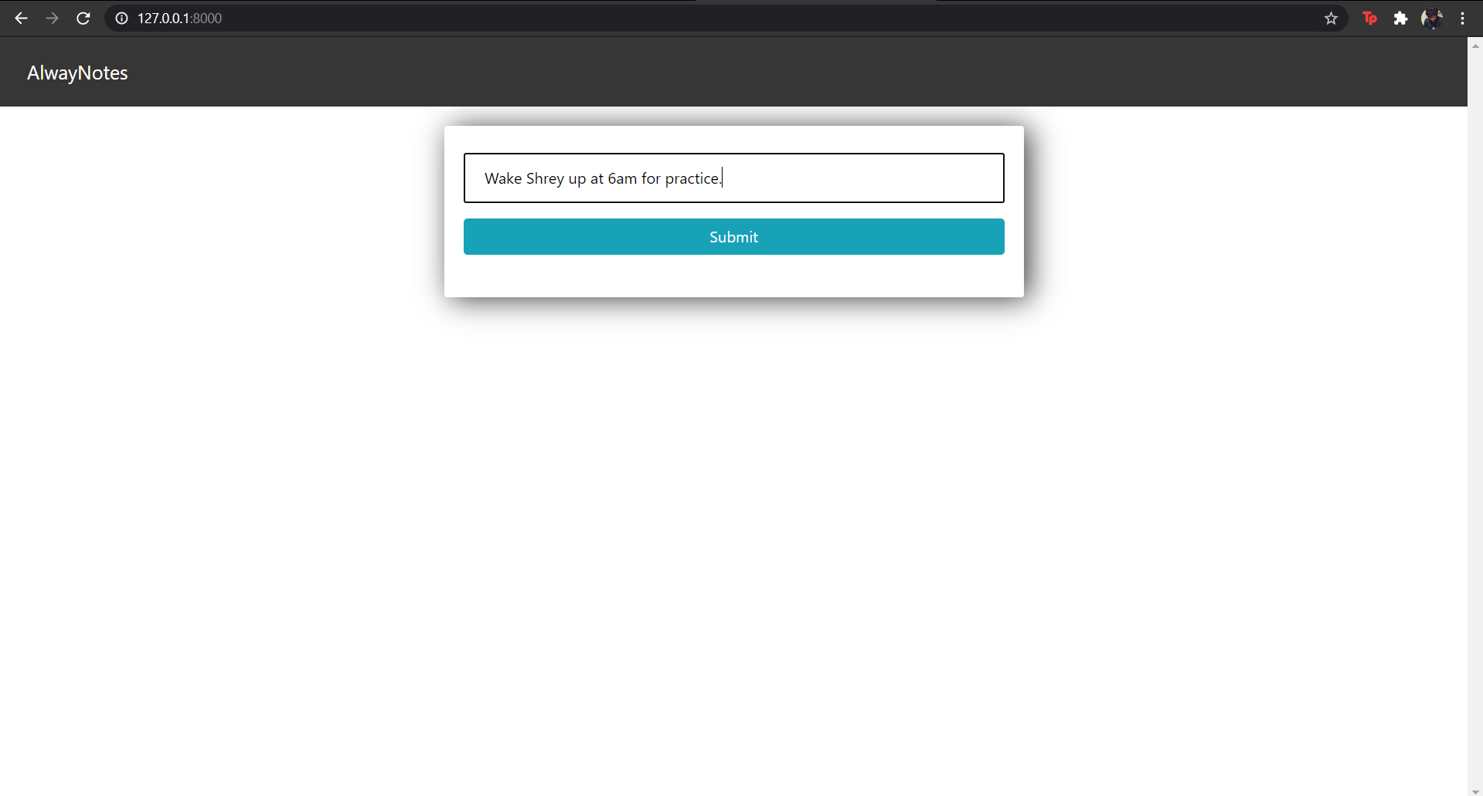
Adding few new tasks:

Slide 39
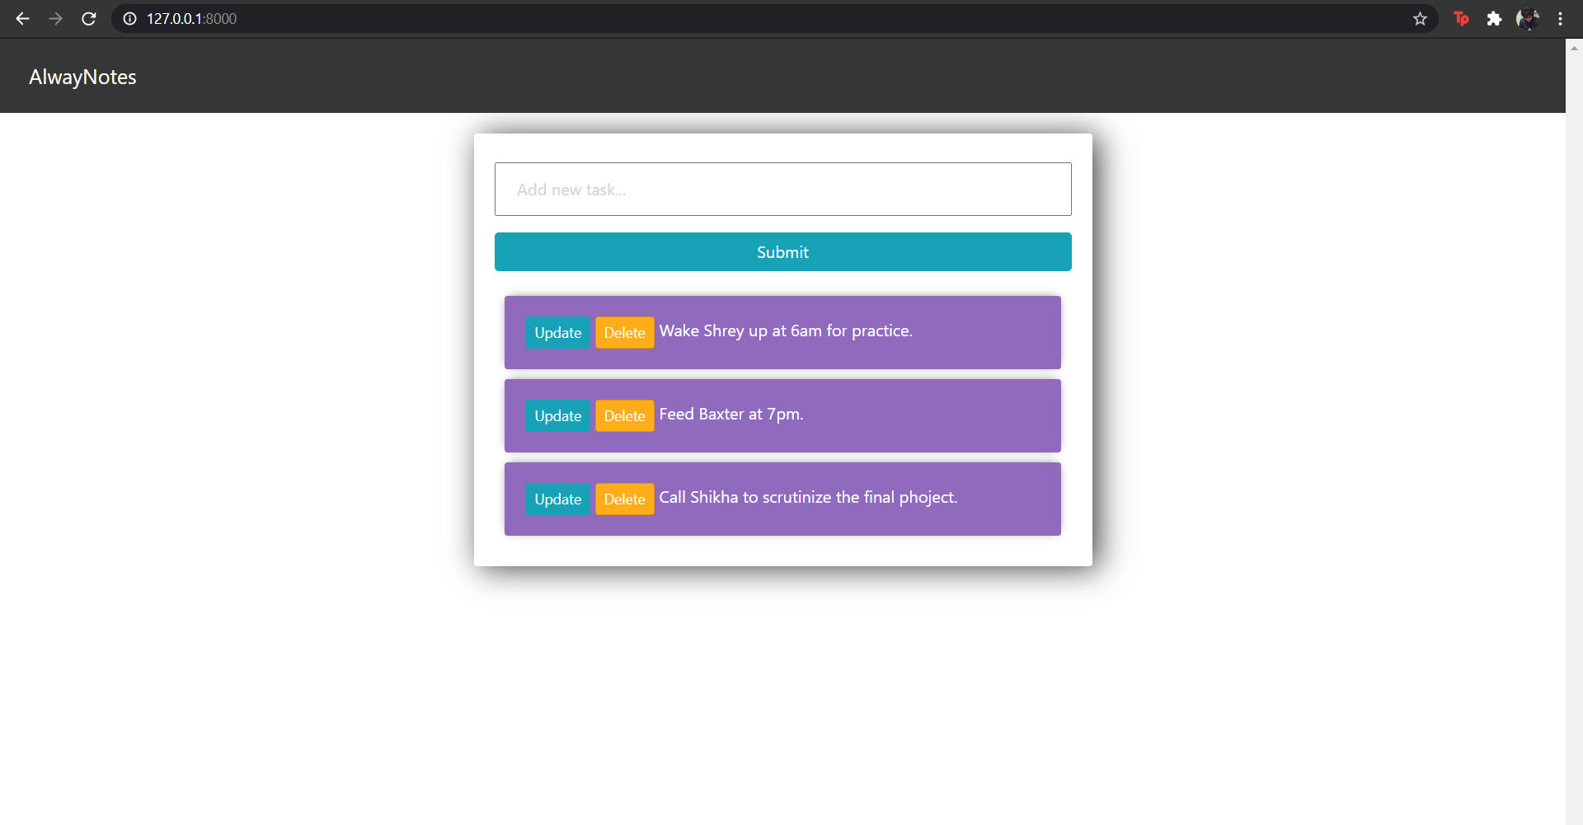
Tasks added:

Slide 40
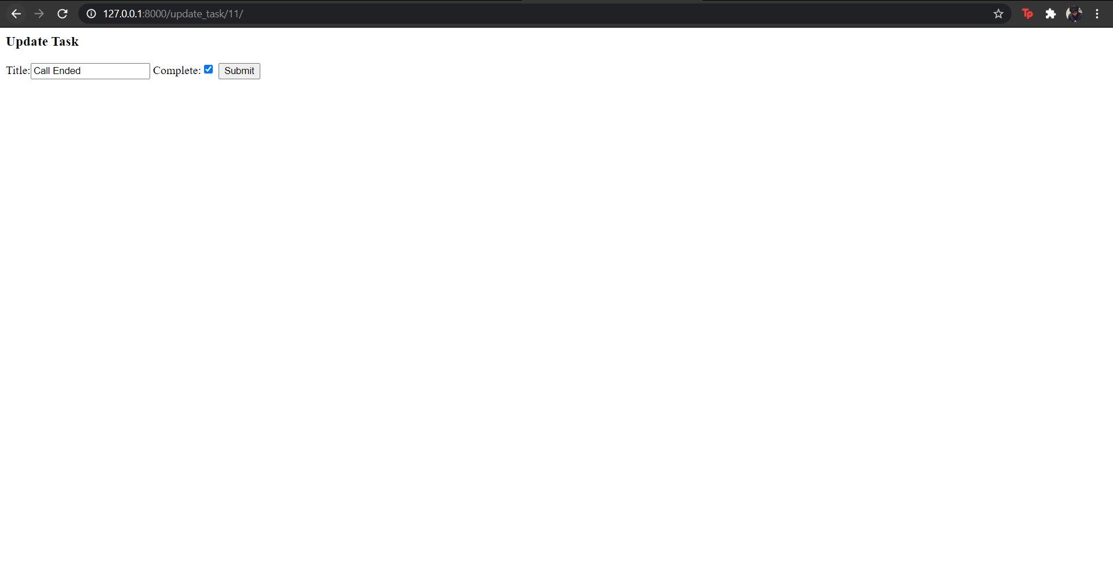
Updating an existing task:

Slide 41
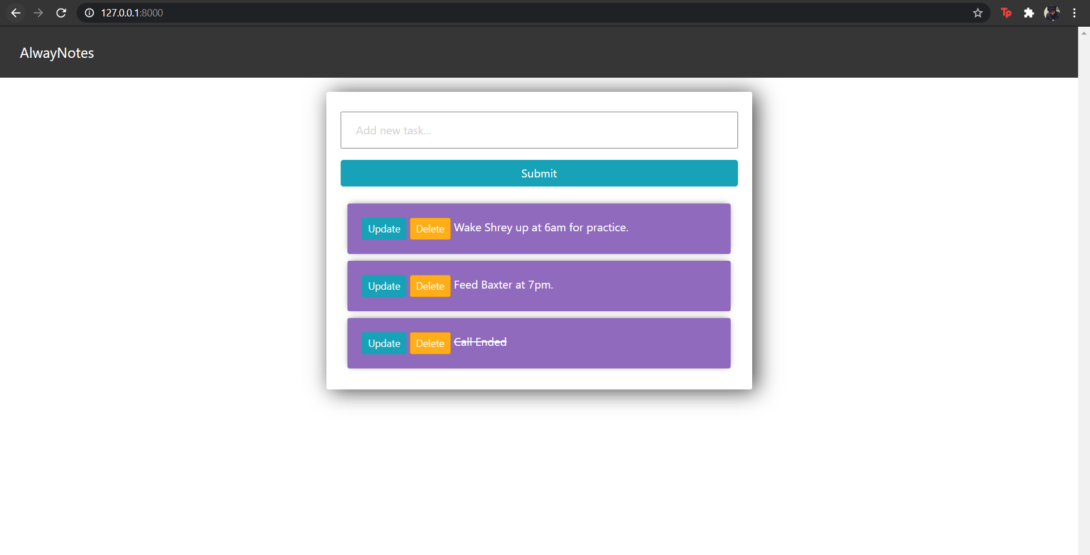
Task updated and completed:

Slide 42
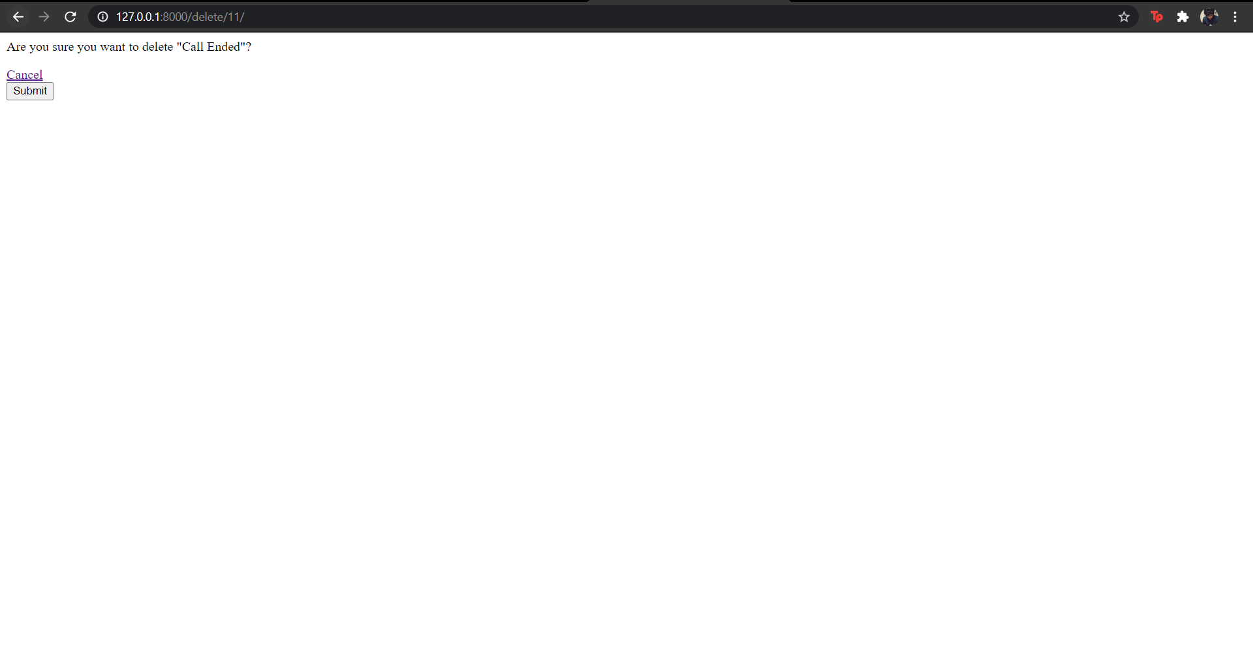
Deleting an existing task:

Slide 43
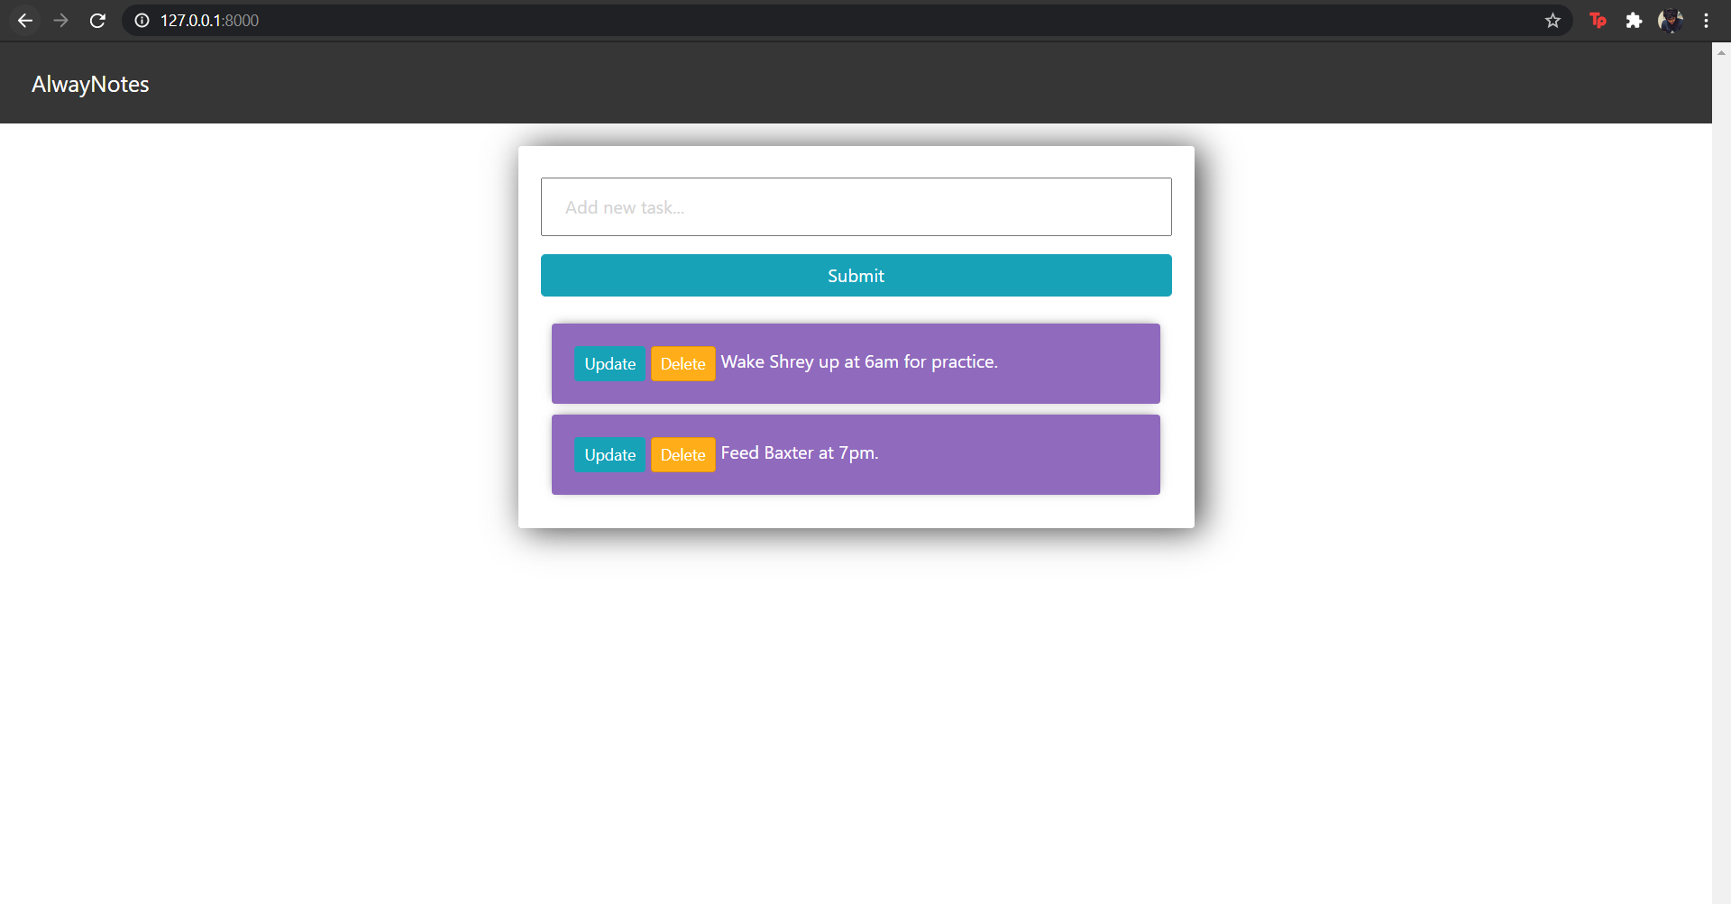
Task deleted:

Slide 44
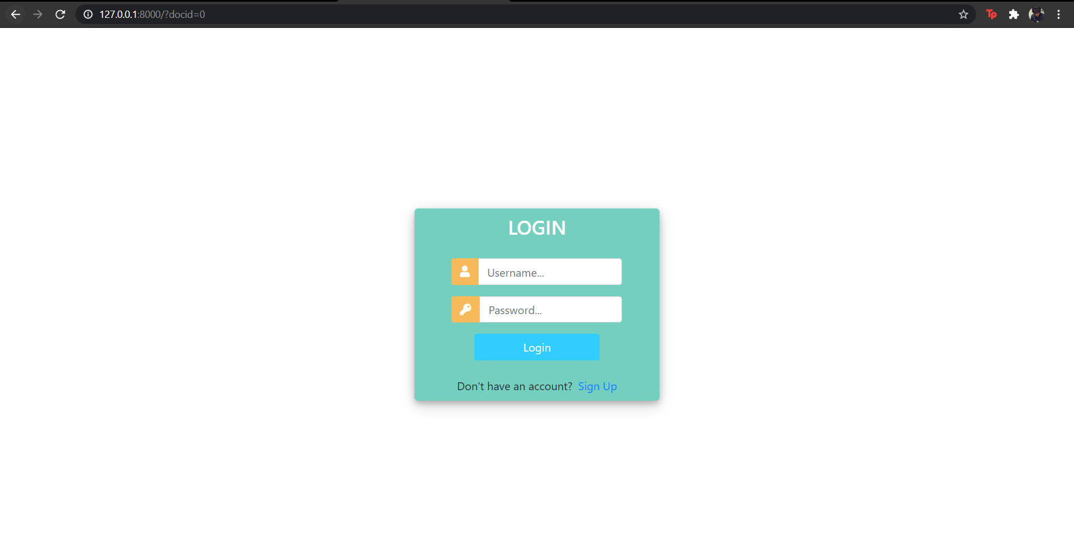
At last after logging out:

Slide 45
Conclusion
This concludes effective note taking of one's ideas is an important thing for an individual rather than noting it down in a piece of paper. Also academically this helps you concentrate, stimulates your ability to recall, and helps you to be organized. You can also share your thoughts and ideas with people in just one click.

Slide 46
Bibliography
https://learning.edx.org/course/course-v1:HarvardX+CS50W+Web/home
Python Tutorial (w3schools.com)
Python Tutorial – Tutorialspoint
Python Courses & Tutorials | Codecademy

Slide 47
THE END

